Slide 1
Power BI Job Simulation Pwc Switzerland
Anuj Kumar
The Data Analyst
B.Tech CSE

Slide 2
Introduction
This report presents the outcomes and insights gained from completing the Power BI Job Simulation with PwC Switzerland. The simulation provided a hands-on experience that mirrors real-world business scenarios, enabling me to step into the role of a data analyst tasked with transforming raw data into actionable insights.

Slide 3
My Experience
Throughout the program, I was exposed to PwC’s approach to solving client challenges through data-driven storytelling and interactive dashboards. Using Microsoft Power BI, I analyzed customer trends, developed visualizations, and derived actionable insights to improve client decision-making and operational strategies.
This simulation not only strengthened my technical proficiency but also sharpened my ability to align analytics with business needs. Which is an essential skill in today’s data-centric world.

Slide 4
📞 Task 1: Analyzing Call Centre Trend

Slide 5
Overview
The first task involved analyzing customer service performance for a fictional client by uncovering key trends in call center operations. Using Microsoft Power BI, I explored call volume patterns, agent responsiveness, and satisfaction scores to pinpoint inefficiencies and service bottlenecks.
This task focused on transforming raw data into a meaningful dashboard that could help stakeholders monitor KPIs, identify underperforming agents, and make strategic decisions to enhance customer experience and service delivery. The ability to segment performance over time enabled a comprehensive understanding of workload distribution and operational consistency.

Slide 6
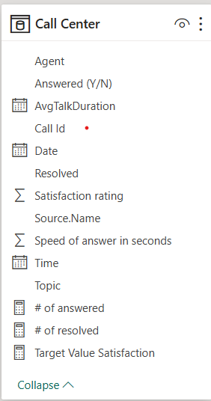
📚 Dataset Introduction
The dataset used for this project represents operational data from PhoneNow’s Call Centre, comprising approximately 47,000 records and spanning 8 key attributes. This rich dataset provides insight into daily call activity, customer interactions, agent responsiveness, and service quality.
Each record corresponds to an individual customer call and contains the following attributes:
Date – The date when the call took place.
Time – The timestamp indicating when the call was initiated.
Topic – The nature of the customer inquiry (e.g., Admin Support, Technical Support, Payment, Contract).
Answered (Y/N) – Indicates whether the call was answered by an agent.
Resolved (Y/N) – Captures whether the customer issue was resolved during the call.
Speed of Answer (in seconds) – Time taken for an agent to answer the incoming call.
Average Talk Duration – The average length of time the agent and customer conversed.
Satisfaction Rating – A customer-provided score reflecting their service experience.

Slide 7
Dax used
# of answered = Calculate(distinctcount('Call Center'[Call Id]),Filter('Call Center','Call Center'[Answered (Y/N)]="Y"))
# of resolved = Calculate(distinctcount('Call Center'[Call Id]),Filter('Call Center','Call Center'[Resolved]="Y"))
Target Value Satisfaction = 4.5

Slide 8
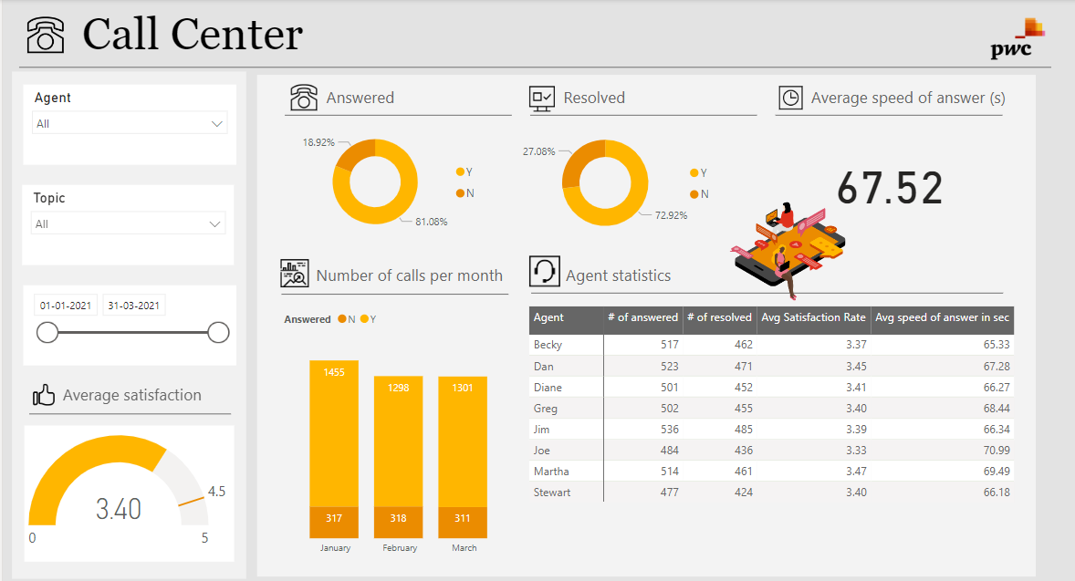
Dashboard

Slide 9
📊 Key Insights from Call Centre Dashboard
Agent Efficiency & Performance
Jim leads in both calls answered (536) and issues resolved (485), making him a benchmark for team productivity.
Martha has the highest satisfaction rating (3.47), suggesting strong customer interaction skills.
Joe has the lowest satisfaction (3.33) and longest speed of answer (70.99 sec), signaling a need for coaching.
Operational Trends Over Time
March saw a slight increase in answered calls compared to February, hinting at possible improvements in coverage.
However, unanswered calls remain consistent (310 per month), indicating a persistent capacity issue.
Customer Experience
The average Speed of Answer is 67.52 seconds, which may be too long for high-volume support environments—opportunity to streamline call routing or staffing.
Satisfaction is moderate at 3.40/5, with room to boost overall service quality through agent training and tech support improvement.
Resolution Gaps
Nearly 27% of calls go unresolved, which may impact churn and customer loyalty—this should trigger deeper root cause analysis.

Slide 10
✅ Recommendations for Stakeholders
Recognize top performers like Jim and Martha to reinforce productivity and customer satisfaction culture.
Coach underperforming agents, particularly Joe, to reduce response time and improve satisfaction.
Improve call handling capacity by analyzing staffing gaps, especially during peak hours with high unanswered calls.
Launch quality enhancement initiatives to reduce unresolved cases and uplift overall service standards.
Streamline call response workflows to bring average speed of answer below 60 seconds.
Monitor satisfaction trends continuously and integrate feedback loops for service improvement.

Slide 11
Thank You

Slide 12








Let’s Connect

